Slide 1

Presentation of Minor Project on SMART PARKING SYSTEM
Guided By:-
Sir Mayank Namdev
Submitted by-
Abhinav Gupta (0133CS161007)
Aditya Tomar (0133CS161015)
Aquib Qureshi (0133CS161042)
Chitransh Dodke (0133CS161061)

Slide 2


Slide 3
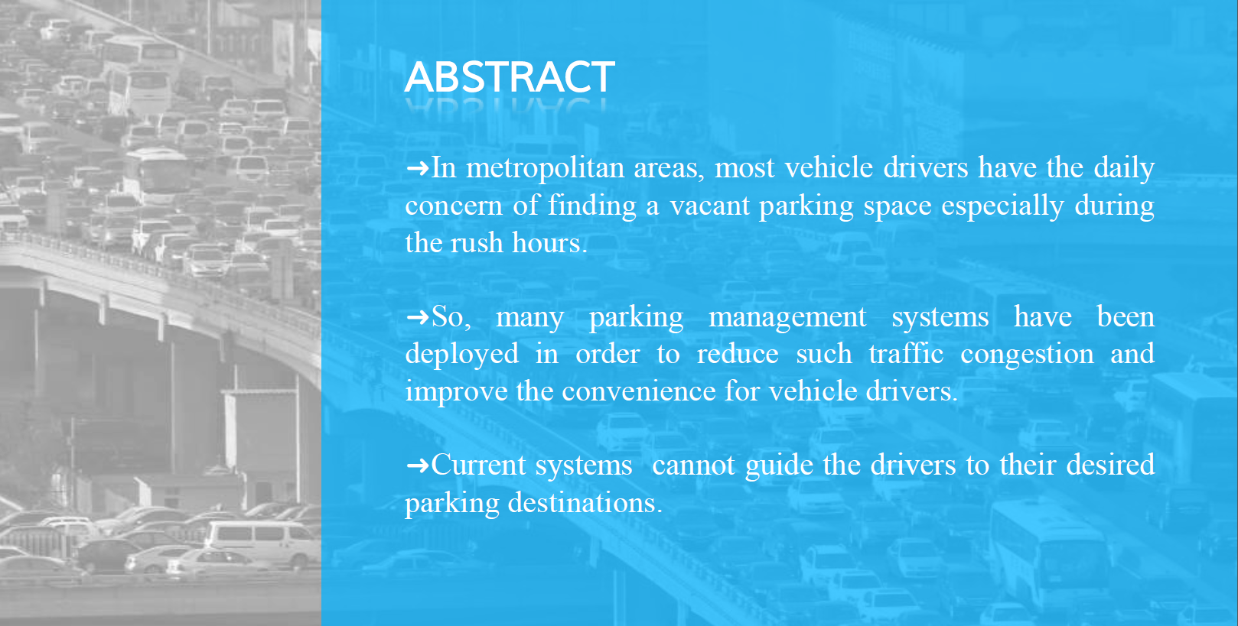

Slide 4


Slide 5
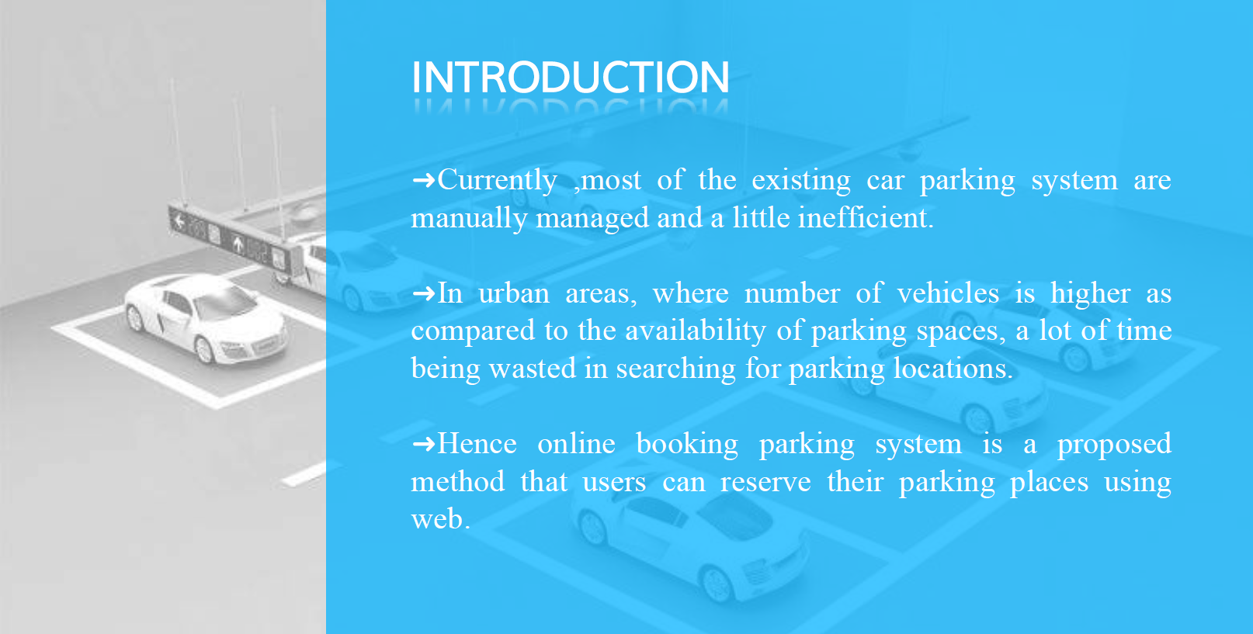

Slide 6
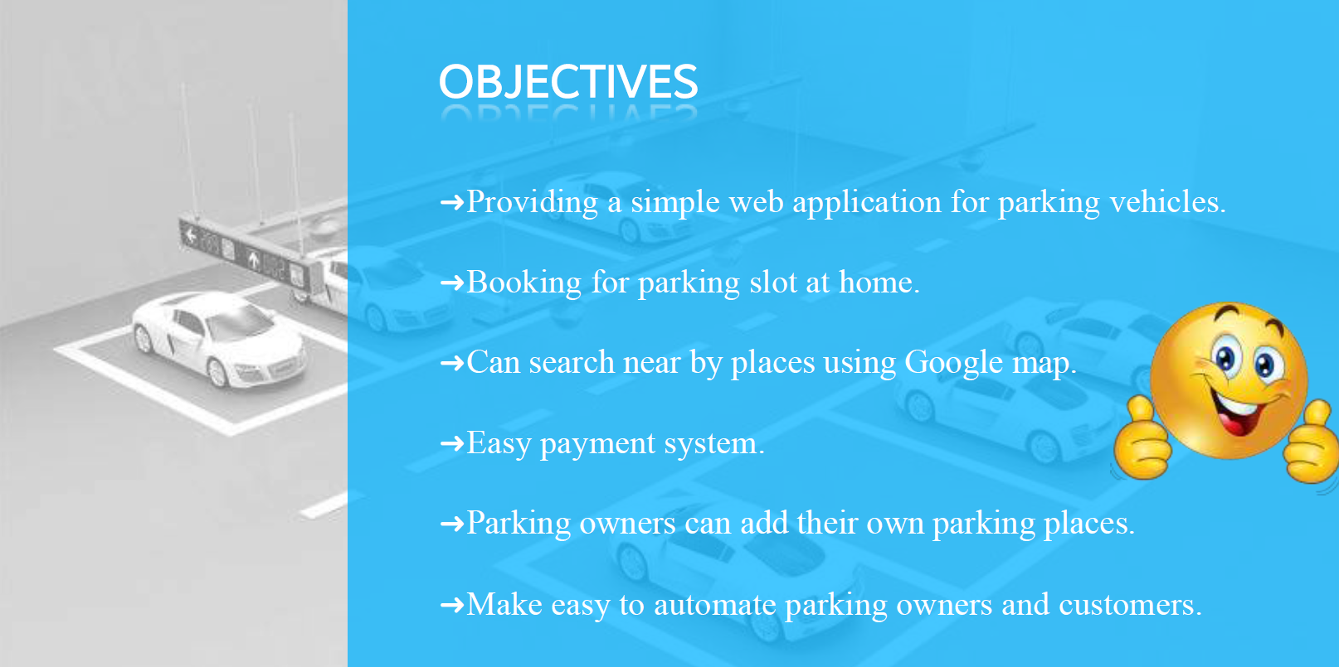

Slide 7
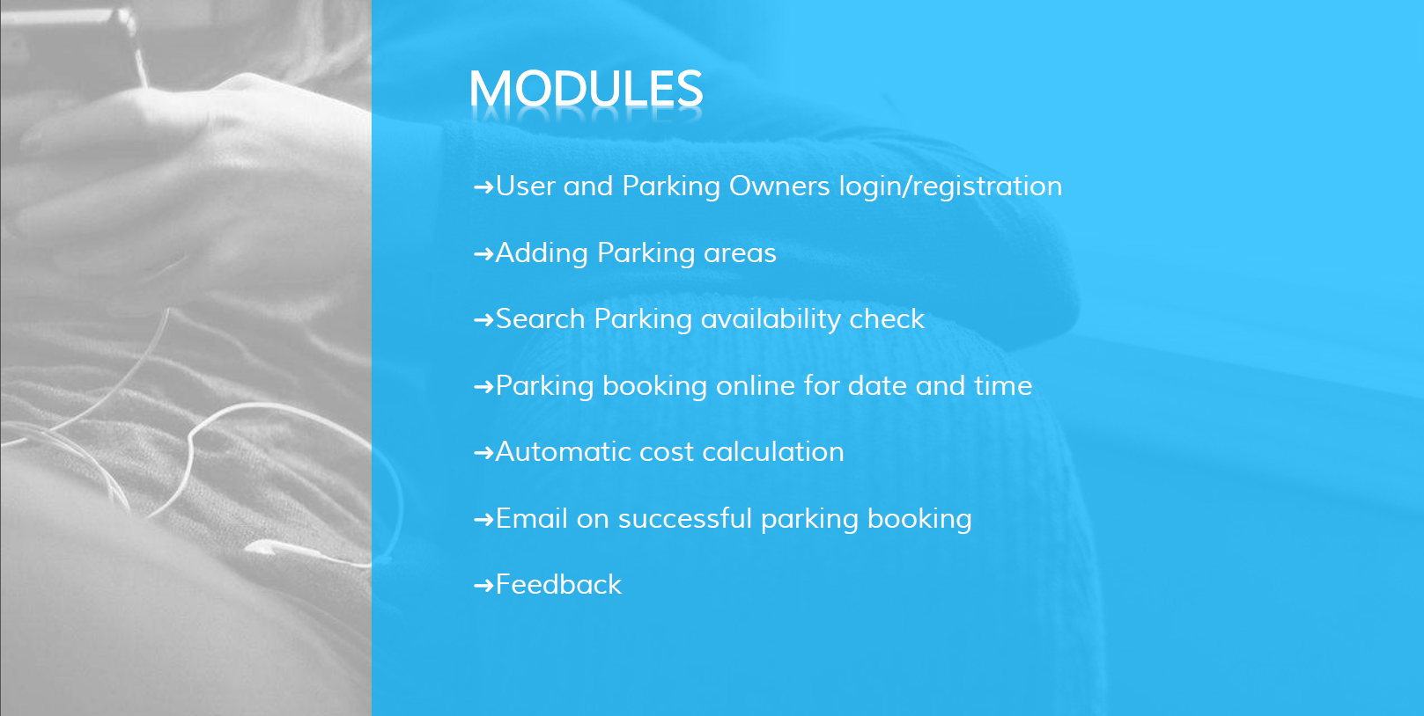

Slide 8
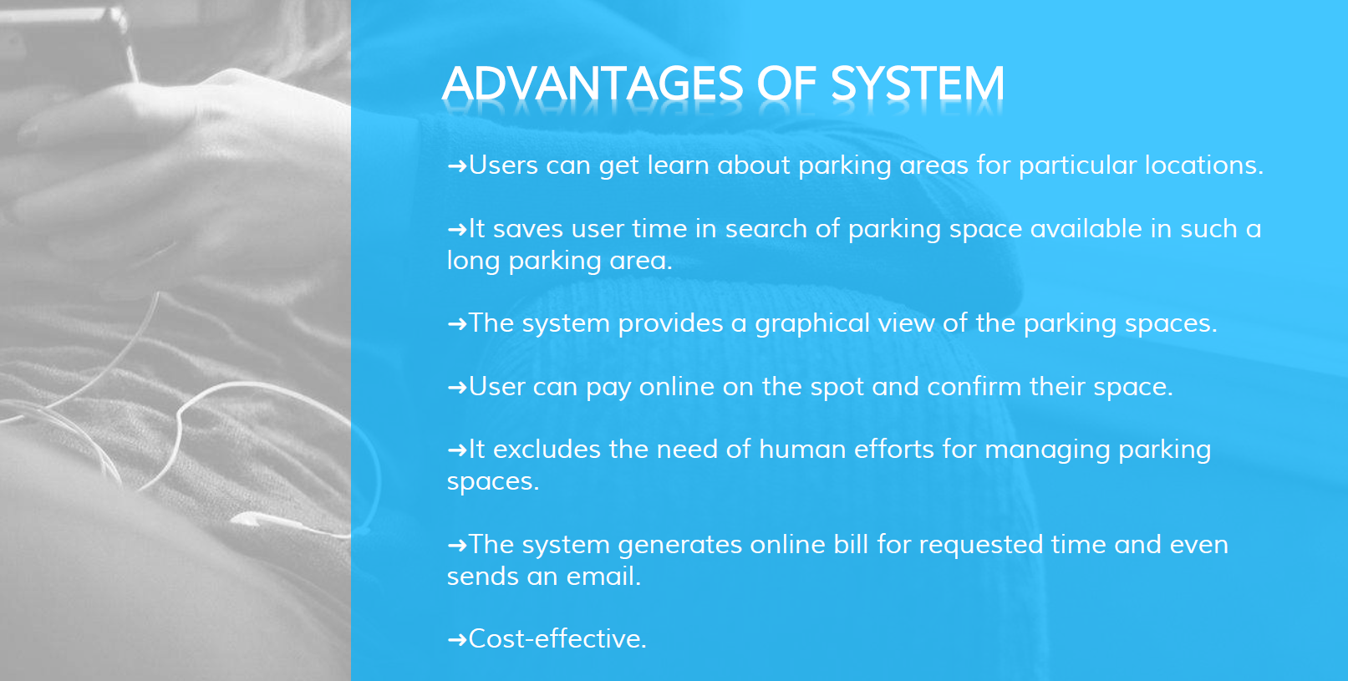

Slide 9


Slide 10
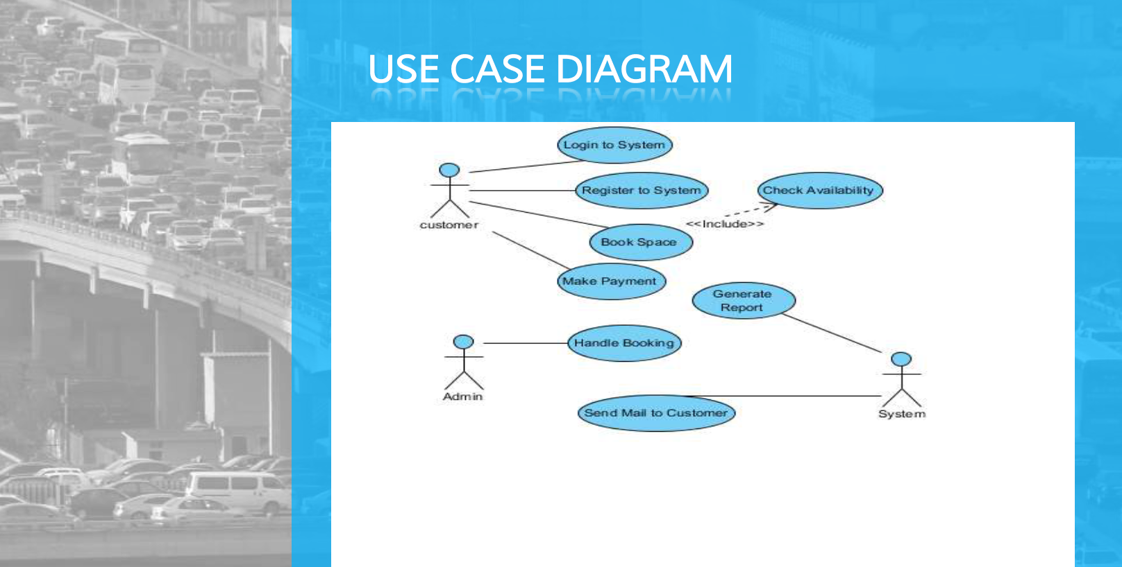

Slide 11
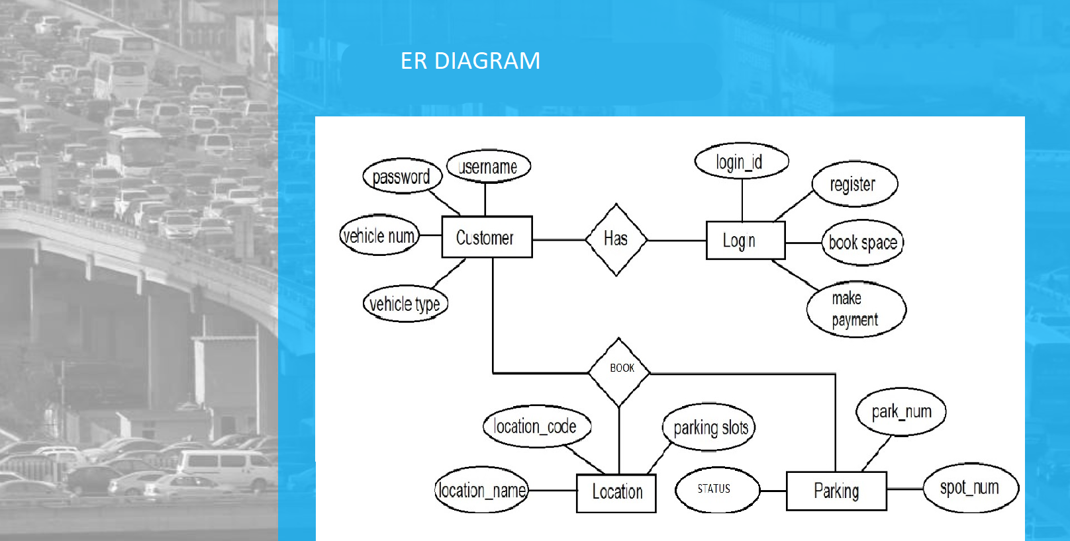

Slide 12
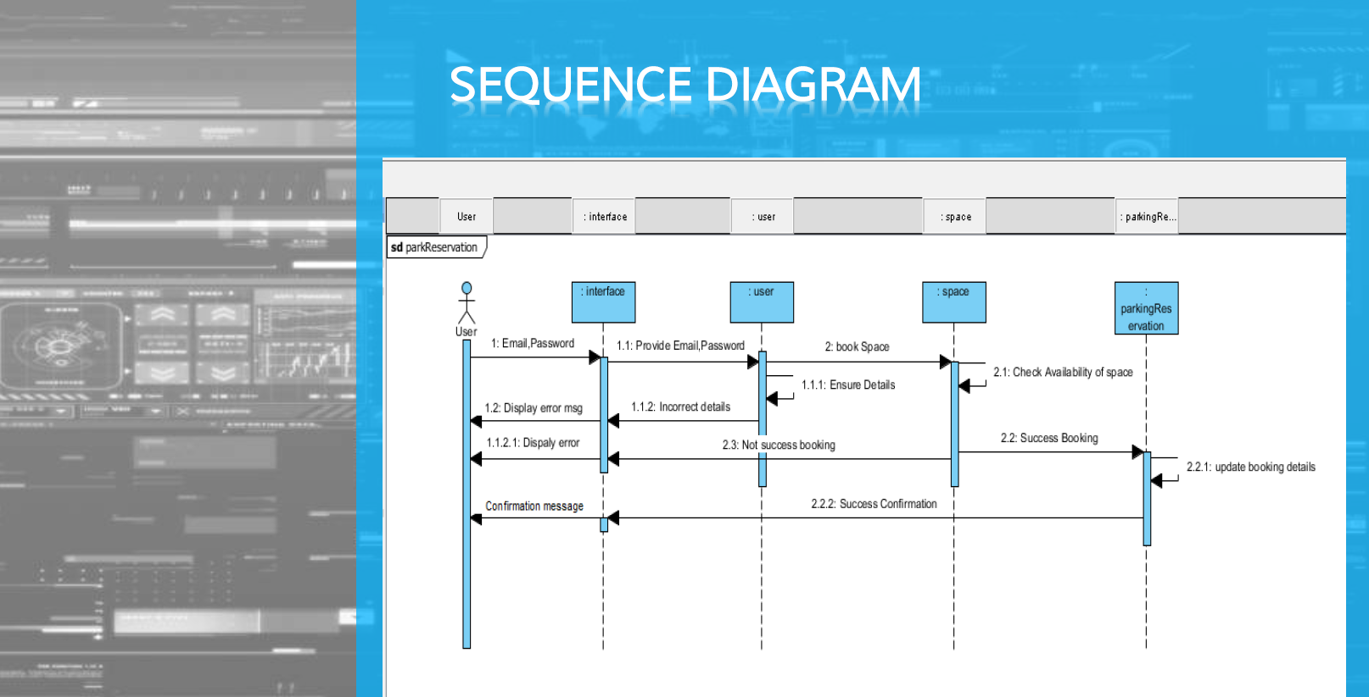

Slide 13


Slide 14
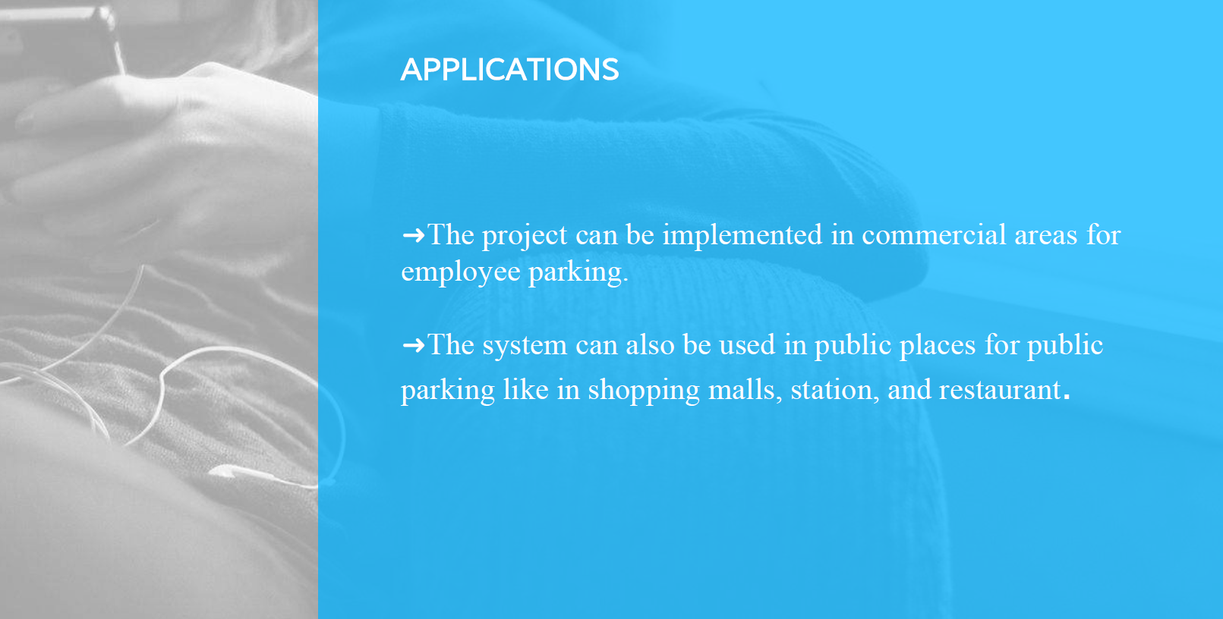

Slide 15


Slide 16
